Slide 1
Gesture Based ui Project
Cathal Ryan

Slide 2
Project idea
For this project I came up with the idea of creating a 2D game, which involved the user navigating the player through obstacles using voice commands.
The main objective of the game is to navigate the player around the different obstacles and reach the chest at the end of the level to progress onto the next level.

Slide 3


How I DEVELOPED THE GAME
I used Unity as the engine for the game.(Main reasoning behind this is because of past experience)
I used Visual Studio 2017 to write all of the C# code.

Slide 4
Main features
Start Menu which is used through voice commands which includes a start button which starts the game and a help button which describes how the game works.
Allows the user to move the player using just voice commands.
As the player progresses through the levels, they start to get more difficult. For example some of the platforms will start to move in the later levels and there is also traps which the player must avoid.

Slide 5
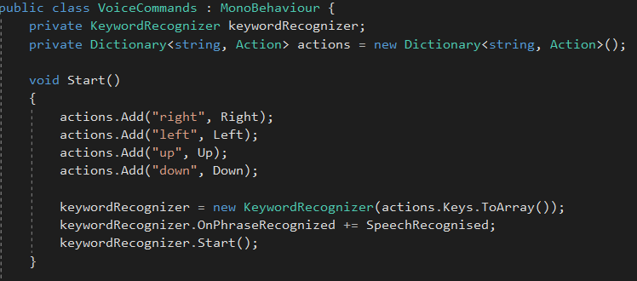
Examples

Slide 6
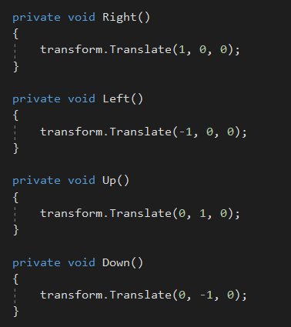
Examples

Slide 7
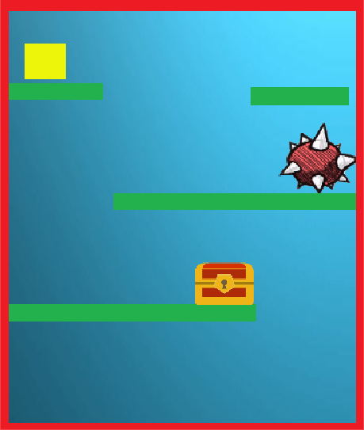
Example of a level

Slide 8
Problems I faced
One of the main problems I faced was that Unity wasn’t picking up any of the voice commands. After research I solved this by going into Unity’s build settings and had to set the microphone to be available to hear voice commands.
Another problem that I faced involved getting the player to be able to stay on moving platforms.

Slide 9
Future plans
Make more appealing ui
Add sounds
Help page

Slide 10
Conclusion
I enjoyed developing this game as some aspects did turn out to be challenging.
I learned how voice commands are integrated into games.
Also learned how voice commands work with games and the methods need for them to work.

Slide 11
LIVE DEMO

